Slide 1
Machine Learning SVM and NB
Dr. Malak Abdullah
Computer Science Department
Jordan University of Science and Technology

Slide 2
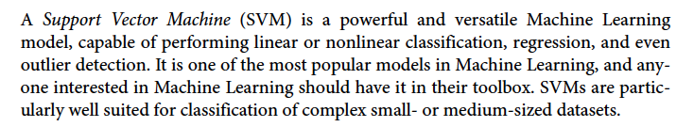
SVM

Slide 3
Classification
Linearly separable classes
Goal: find a linear decision boundary (hyperplane) that separates the classes

Slide 4
Linearly separable classes
One possible solution

Slide 5
Linearly separable classes
Another possible solution

Slide 6
Linearly separable classes
Other possible solutions

Slide 7
Which one is better?
Which one is better? B1 or B2? How do you define better?

Slide 8
Which one is better?
Fitting the widest possible street between classes ☺
Hyperplane that maximizes the margin will have better generalization => B1 is better than B2

Slide 9
Noisy data
Hyperplane that maximizes the margin will have better generalization => B1 is better than B2

Slide 10
Noisy data
The Maximum Margin Classifier is our first SVM. But this SVM requires the two classes to be completely linearly separated. This isn’t always the case so in 1993 Vapnik developed another one of his machines.
This is the Maximum Margin Classifier. It maximizes the margin of the hyperplane. This is the best hyperplane because it reduces the generalization error the most. If we add new data, the Maximum Margin Classifier is the best hyperplane to correctly classify the new data.
Hyperplane that maximizes the margin will have better generalization => B1 is better than B2

Slide 11
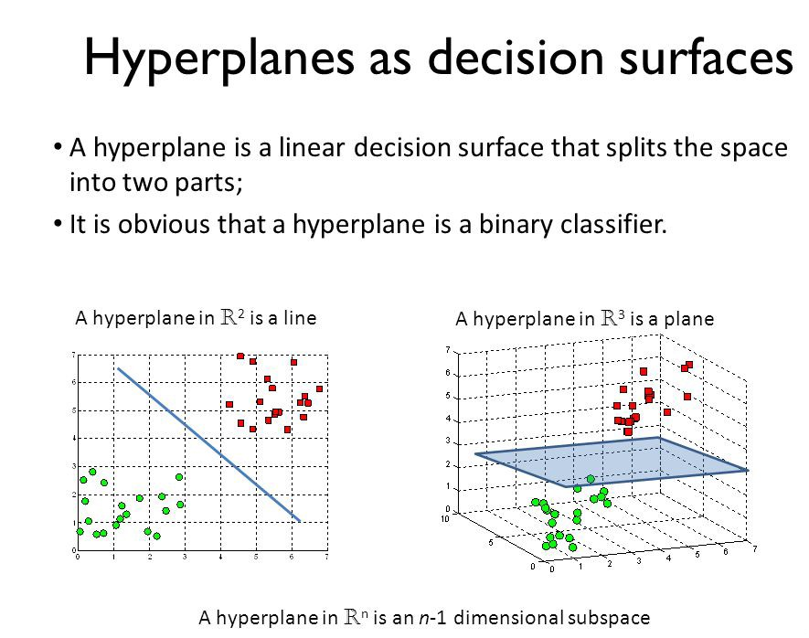
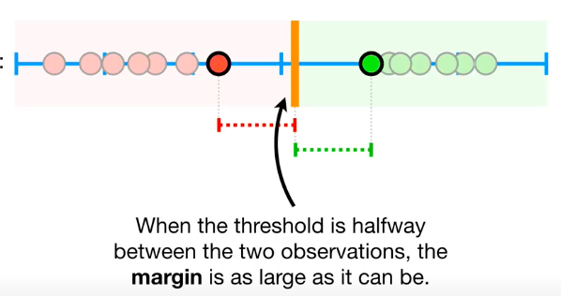

Slide 12
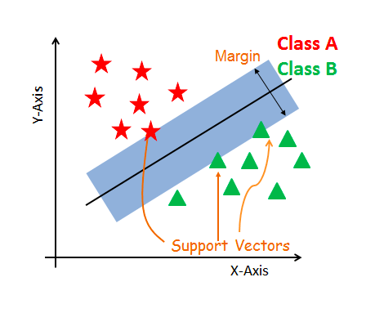
The core idea of SVM
SVM constructs a hyperplane in multidimensional space to separate different classes.
SVM generates optimal hyperplane in an iterative manner, which is used to minimize an error.
The core idea of SVM is to find a maximum marginal hyperplane(MMH) that best divides the dataset into classes.

Slide 13
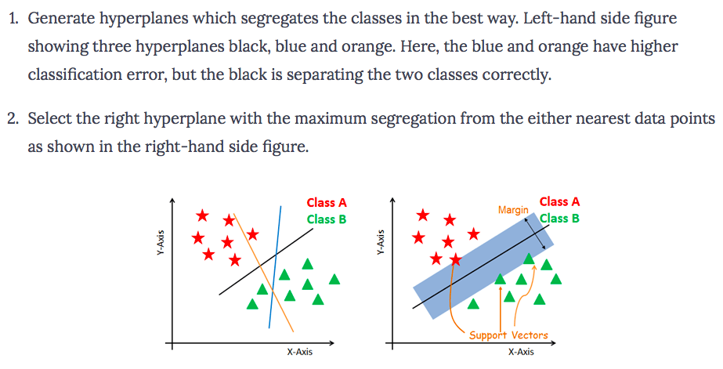
How does SVM work?
The objective is to select a hyperplane with the maximum possible margin between support vectors in the given dataset. Follow these steps:

Slide 14
Terminologies
Support vectors are the data points, which are closest to the hyperplane. These points will define the separating line better by calculating margins.
A hyperplane is a decision plane which separates between a set of objects having different class memberships.
A margin is a gap between the two lines on the closest class points. if the margin is larger in between the classes, then it is considered a good margin, a smaller margin is a bad margin.
large margin classifiers, maximum margin classifiers
Support Vector Classifier, soft marginal classifier
Support Vector Machines

Slide 15
Margin
The distance between the line and the closest data points is referred to as the margin.
The best or optimal line that can separate the two classes is the line that as the largest margin.

Slide 16
Margin
X ⁺
M=Margin Width
“Predict Class = +1” zone
X ⁻
wx+b=1
wx+b=0
“Predict Class = -1” zone
wx+b=-1
What we know:
w . x⁺ + b = +1
w . x⁻ + b = -1
w . (x⁺-x⁻⁾ = 2

Slide 17
Maximum Margin
We want to maximize:
But subject to the following constraints:

Slide 18
Which one is better?
Hard Margin:
we require all data points be classified correctly
No training error
Now which one is better? B1 or B2? How do you define better?

Slide 19
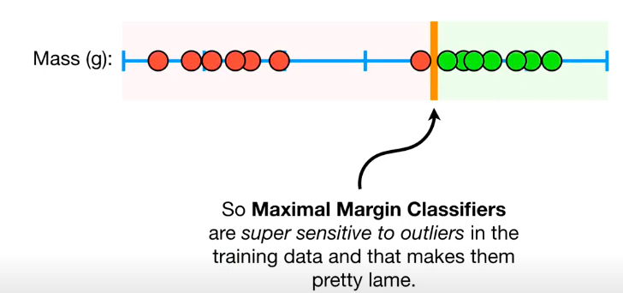
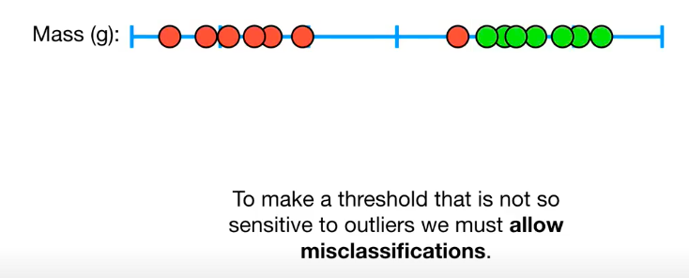
Underfitting vs Overfitting
In this case, the Maximum Margin Classifier would not work. Vapnik developed a soft margin that would allow for some misclassification of data.
https://www.youtube.com/watch?v=efR1C6CvhmE

Slide 20
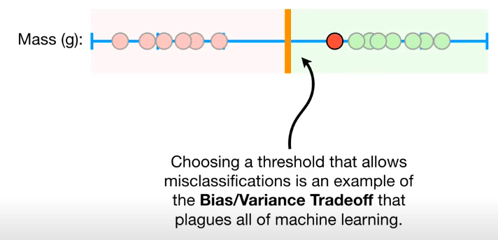

Slide 21
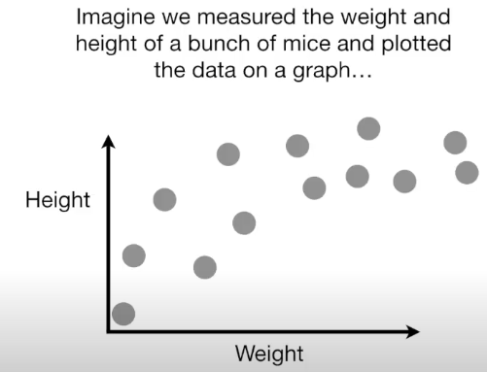
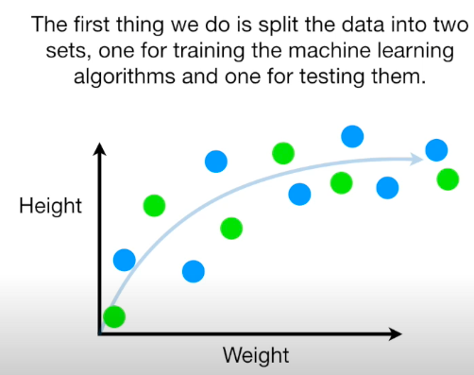
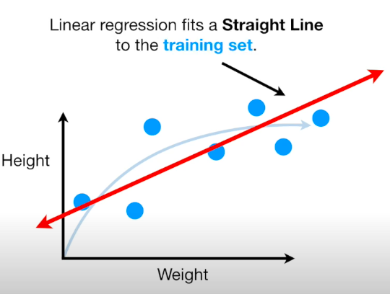
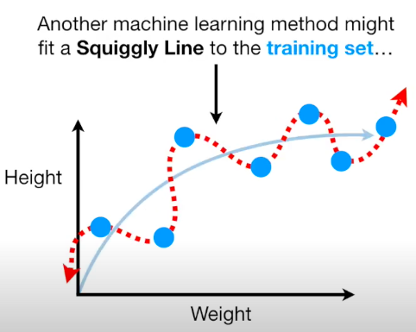
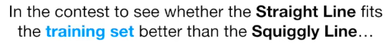
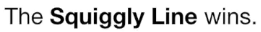
Lets talk about Bias vs Variance

Slide 22
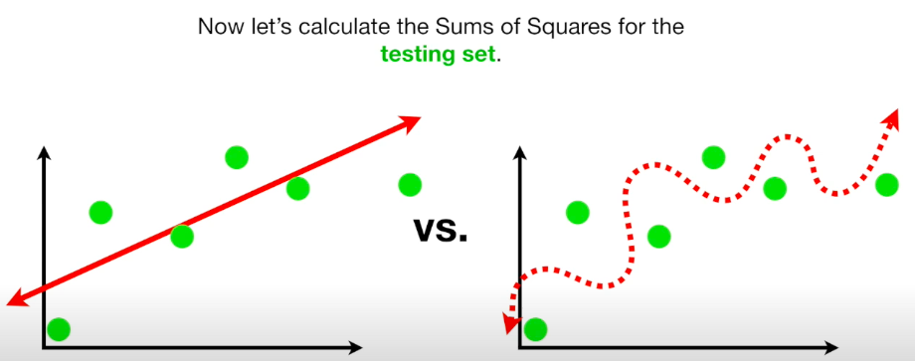
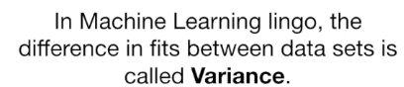
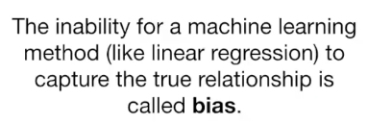
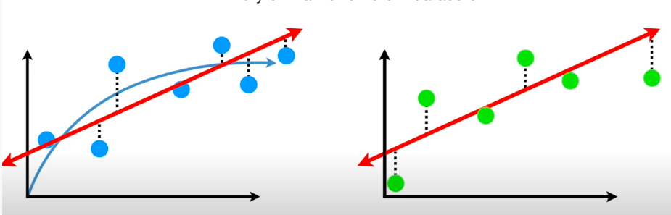
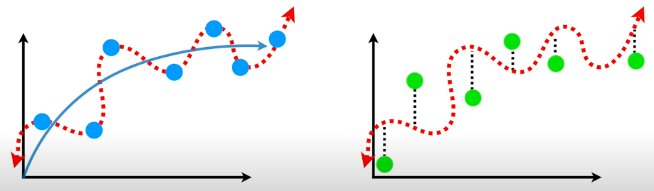
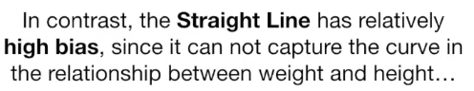
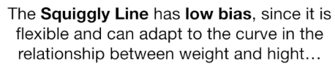
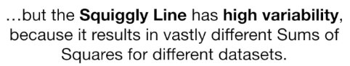
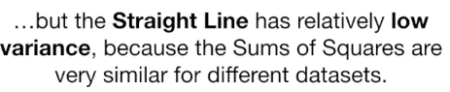

Slide 23
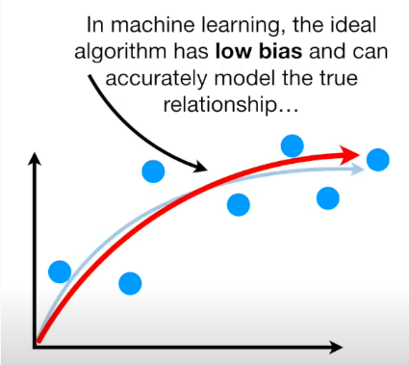
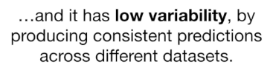
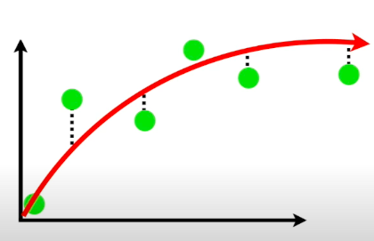

Slide 24
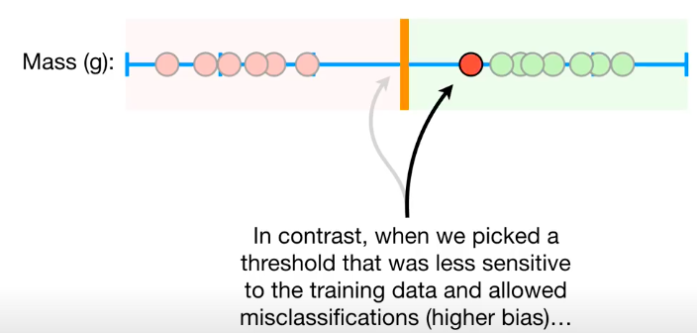
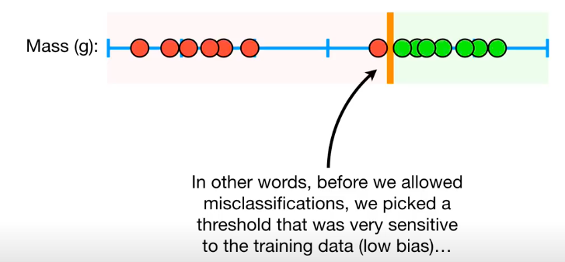
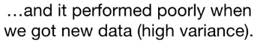
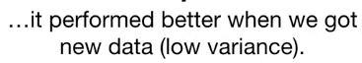
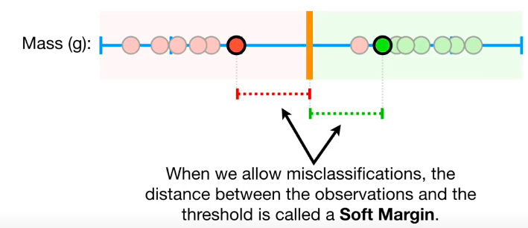

Slide 25
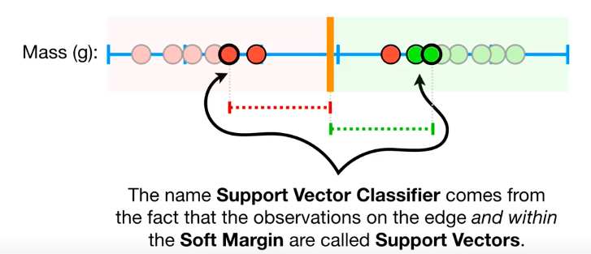
This is known as a Soft Margin Classifier or a Support Vector Classifier. It also attempts to maximize the margin separating the two classes.

Slide 26
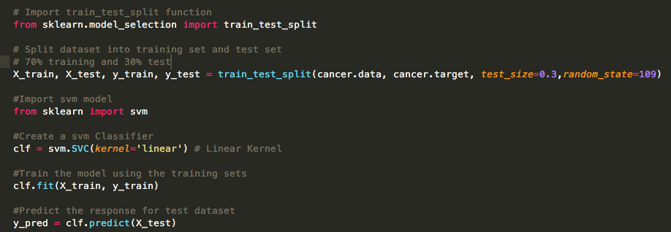
Split, fit, and predict
From sklearn. Svm import linearSVC Is much faster ☺

Slide 27
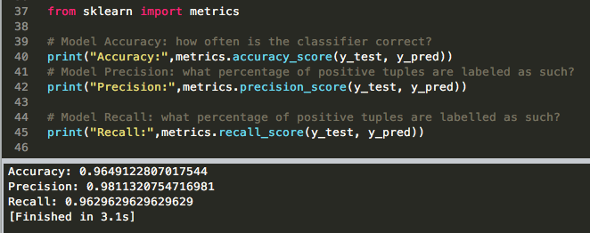
Evaluating

Slide 28
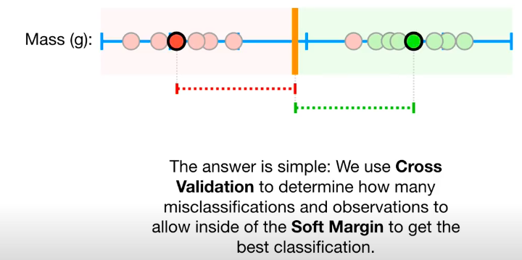
How Do we know which soft margin to choose?

Slide 29
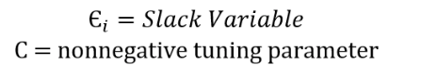
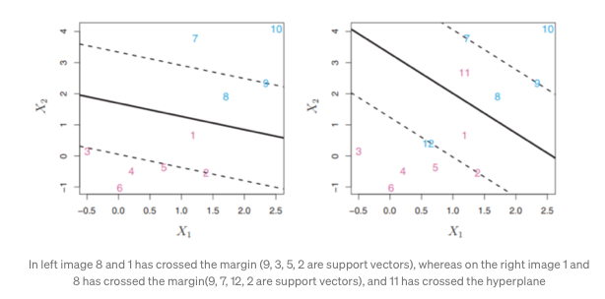
The support vector classifier contains a tuning parameter in order to control how much misclassification it will allow.
This tuning parameter is important when looking to minimize error. As with all supervised learning, there is a bias-variance tradeoff.
If the slack variable is equal to zero then it means that “i th” observation is on correct side of margin and if slack variable is > than 0 then it means “i th” observation is on wrong side of margin. If slack variable is greater than 1 then “i th” observation is on the wrong side of the hyperplane.
The variable C is the penalty strength, which specifies how much do we care about errors (training points that are on the wrong side).

Slide 30
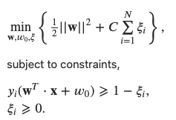
Soft Margin Classification
If the training set is not linearly separable, Slack variables ξ_{i} can be added to allow misclassification of difficult or noisy examples, resulting margin called soft.
We can now consider a combined effect. We would like to maximize the margin and allow for total error of some magnitude. Optimization problem takes the form
What should our quadratic optimization criterion be?
Minimize
ξ_{i}
ξ_{i}

Slide 31
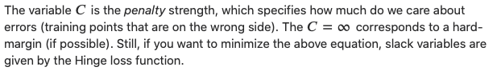
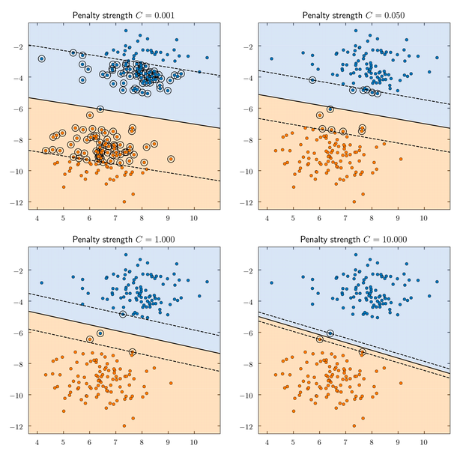

Slide 32
The old formulation:
The new formulation incorporating slack variables:
Parameter C can be viewed as a way to control overfitting.
Find w and b such that
Φ(w) =½ w^{T}w is minimized and for all {(x_{i} ,y_{i})}
y_{i} (w^{T}x_{i} + b) ≥ 1
Find w and b such that
Φ(w) =½ w^{T}w + CΣξ_{i} is minimized and for all {(x_{i} ,y_{i})}
y_{i} (w^{T}x_{i} + b) ≥ 1- ξ_{i} and ξ_{i} ≥ 0 for all i

Slide 33
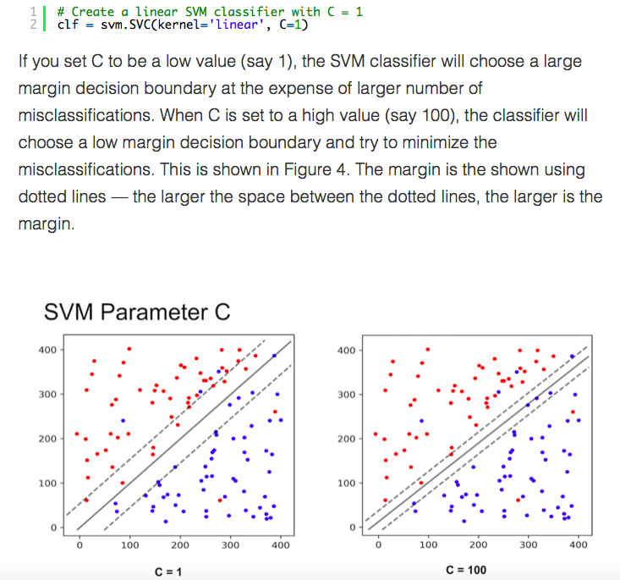
Noisy data
You may be tempted to ask which value of C is better. The answer depends on how much noise you think there is in your data. If you think the data is very noisy, you want C to be small. On the other hand, if you think the data is less noisy, you should choose C to be large.

Slide 34
SVM Support Vector Machine
SVM offers very high accuracy compared to other classifiers
It is used in a variety of applications such as face detection, intrusion detection, classification of emails, news articles and web pages, classification of genes, and handwriting recognition
The classifier separates data points using a hyperplane with the largest amount of margin. That's why an SVM classifier is also known as a discriminative classifier. SVM finds an optimal hyperplane which helps in classifying new data points.

Slide 35
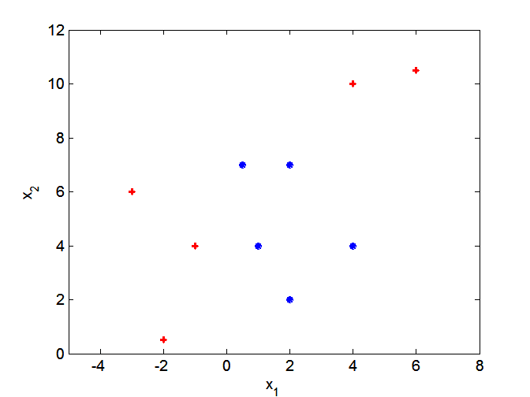
Support vector machines
What if decision boundary is not linear?

Slide 36
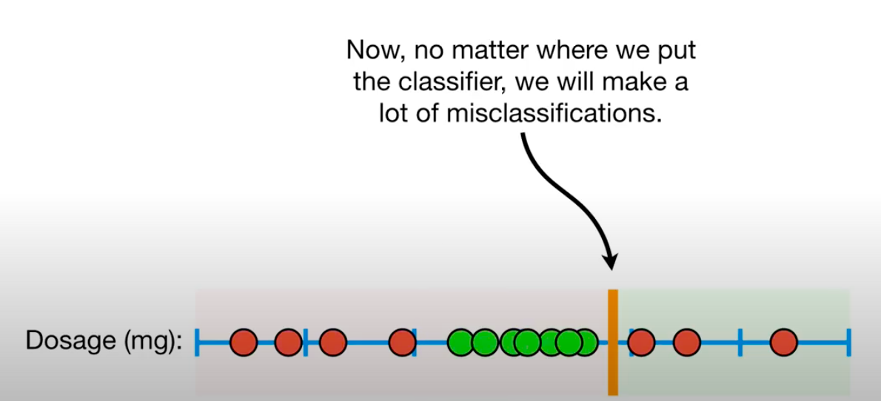

Slide 37
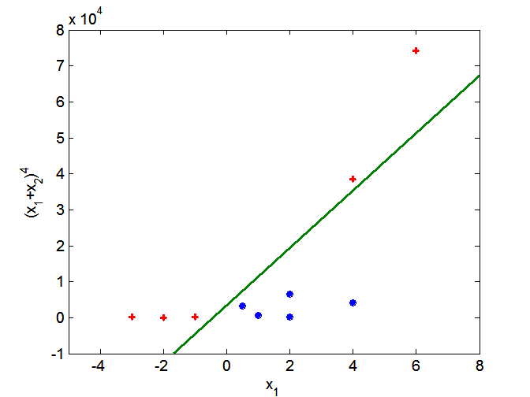
Support vector machines
Solution: nonlinear transform of attributes
One approach to
handling nonlinear datasets is to add more features, such as polynomial features

Slide 38
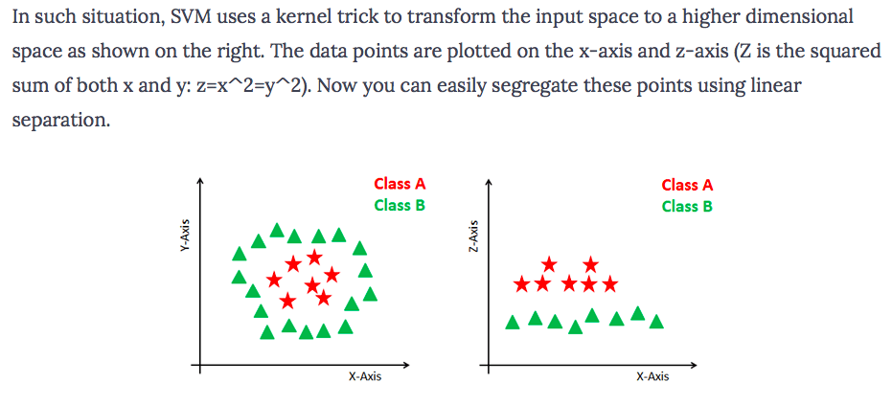
Dealing with non-linear and inseparable planes
Some problems can’t be solved using linear hyperplane:

Slide 39
Support vector machines
Solution: nonlinear transform of attributes

Slide 40
Non-linear SVMs: Feature spaces
General idea: the original feature space can always be mapped to some higher-dimensional feature space where the training set is separable:
Φ: x → φ(x)

Slide 41
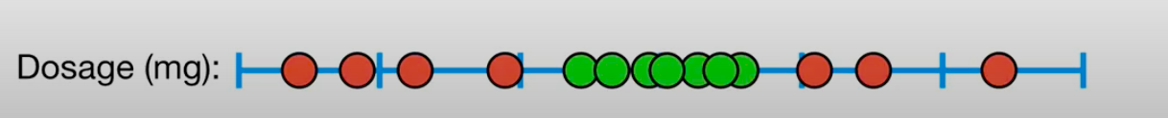
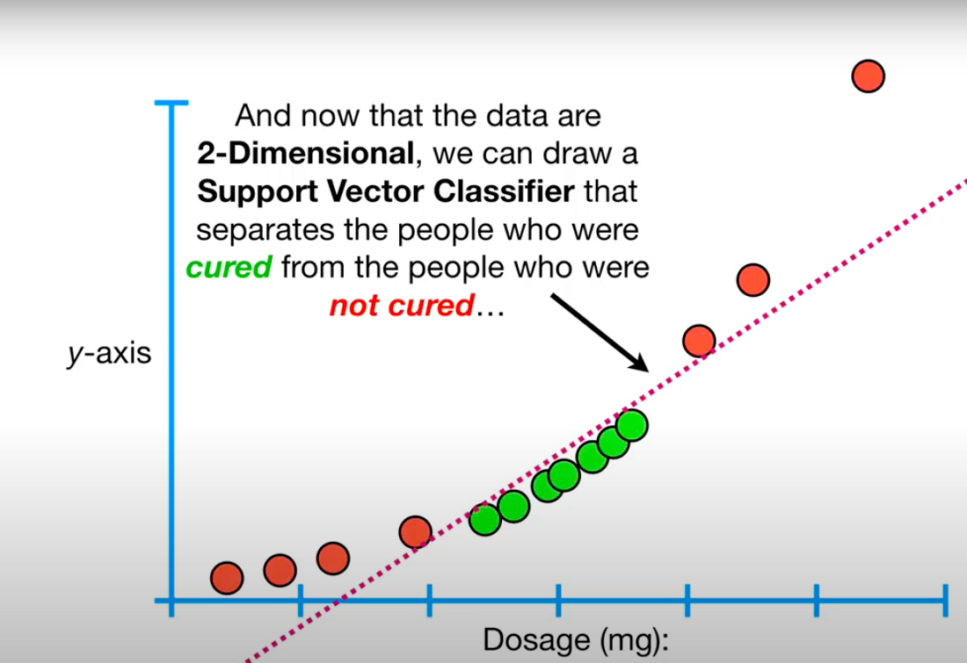
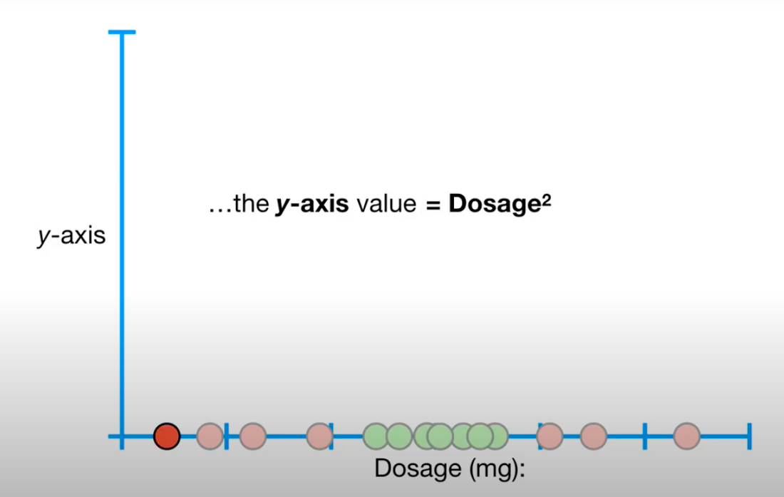

Slide 42
SVM Kernels
The SVM algorithm is implemented in practice using a kernel.
A kernel transforms an input data space into the required form.
SVM uses a technique called the kernel trick. Here, the kernel takes a low-dimensional input space and transforms it into a higher dimensional space.
Kernel trick helps you to build a more accurate classifier.
Kernel: The main function of the kernel is to transform the given dataset input data into the required form. There are various types of functions such as linear, polynomial, and radial basis function (RBF). Polynomial and RBF are useful for non-linear hyperplane.
Polynomial and RBF kernels compute the separation line in the higher dimension. In some of the applications, it is suggested to use a more complex kernel to separate the classes that are curved or nonlinear. This transformation can lead to more accurate classifiers.

Slide 43
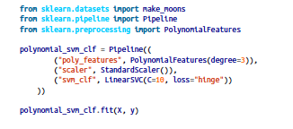
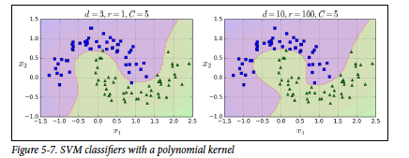

Polynomial Kernel

Slide 44

Gaussian RBF Kernel
In such a case, we use the Kernel Trick where we add a new dimension to existing data and if we are lucky, in the new space, the data is linearly separable.
Lets add a third dimension (z) to the data where,
The above expression is called a Gaussian Radial Basis Function or a Radial Basis Function with a Gaussian kernel.

Slide 45


Slide 46


Slide 47


Slide 48


Slide 49


Slide 50

Regression
The SVM algorithm is versatile: not only does it support linear and nonlinear classification, but it also supports linear and nonlinear regression. To use SVMs for regression instead of classification, the trick is to reverse the objective: instead of trying to fit the largest possible street between two classes while limiting margin violations, SVM Regression tries to fit as many instances as possible on the street while limiting margin violations (i.e., instances off the street).

Slide 51
Advantages
SVM Classifiers offer good accuracy and perform faster prediction compared to Naïve Bayes algorithm. They also use less memory because they use a subset of training points in the decision phase. SVM works well with a clear margin of separation and with high dimensional space.
Disadvantages
SVM is not suitable for large datasets because of its high training time and it also takes more time in training compared to Naïve Bayes. It works poorly with overlapping classes and is also sensitive to the type of kernel used.

Slide 52
SVM applications
SVMs were originally proposed by Boser, Guyon and Vapnik in 1992 and gained increasing popularity in late 1990s.
SVMs are currently among the best performers for a number of classification tasks ranging from text to genomic data.
SVMs can be applied to complex data types beyond feature vectors (e.g. graphs, sequences, relational data) by designing kernel functions for such data.
SVM techniques have been extended to a number of tasks such as regression [Vapnik et al. ’97], principal component analysis [Schölkopf et al. ’99], etc.
Tuning SVMs remains a black art: selecting a specific kernel and parameters is usually done in a try-and-see manner.
More mathematical material you can find in the text book!
Demo ☺
http://vision.stanford.edu/teaching/cs231n-demos/linear-classify/
https://cs.stanford.edu/people/karpathy/svmjs/demo/

Slide 53
Naïve Bayes

Slide 54

Naive Bayes
One of the most powerful algorithms for classification based on Bayes' Theorem with an assumption of independence among predictors.
The Naive Bayes classifier assumes that the presence of a feature in a class is unrelated to any other feature.
In statistics and probability theory, Bayes' theorem describes the probability of an event, based on prior knowledge of conditions that might be related to the event. It serves as a way to figure out conditional probability.

Slide 55
REMINDER: Probability Basics
We defined prior, conditional and joint probability for random variables
Prior probability:
Conditional probability:
Joint probability:
Relationship:
Independence:
Bayesian Rule

Slide 56

Bayes' Theorem Example
Let's suppose we have Cards and we wish to find out the probability of the card we picked at random to being a king, given that it is a face card. So, according to Bayes' Theorem, we can solve this problem. First, we need to find out the probability:
P(King) which is 4/52 as there are 4 Kings in Cards.
P(Face|King) is equal to 1 as all the Kings are face Cards.
P(Face) is equal to 12/52 as there are 3 Face Cards in a Suit of 13 cards and there are 4 Suits in total.

Slide 57

example
Imagine you take a random sample of 500 passengers. In this sample, 30% of people survived. Among passenger who survived, the fare ticket mean is 100$. It falls to 50$ in the subset of people who did not survive. Now, let’s say you have a new passenger. You do not know if he survived or not but you know he bought a 30$ ticket to cross the Atlantic. What is your prediction of survival for this passenger?

Slide 58
Not survive
You probably answered that this passenger did not survive. Why?
You assumed that chances of survival were low and that being poor reduced chances of survival.
You put this passenger in the closest group of likelihood (the low fare ticket group).
This is what the Naive Bayes classifier does.

Slide 59

Naïve Assumption
assumption of independence among features. What does it mean?
For example, it means we have to assume that the comfort of the room on the Titanic is independent of the fare ticket.
This assumption is absolutely wrong and it is why it is called Naive. It allows to simplify the calculation, even on very large datasets.
Naïve bayse: finding functions describing the probability of belonging to a class given features.

Slide 60

Tennis Example
Example: Play Tennis

Slide 61
The learning phase for tennis example
P(Play=Yes) = 9/14
P(Play=No) = 5/14
We have four variables, we calculate for each we calculate the conditional probability table
Outlook | Play=Yes | Play=No
Sunny | 2/9 | 3/5
Overcast | 4/9 | 0/5
Rain | 3/9 | 2/5
Temperature | Play=Yes | Play=No
Hot | 2/9 | 2/5
Mild | 4/9 | 2/5
Cool | 3/9 | 1/5
Humidity | Play=Yes | Play=No
High | 3/9 | 4/5
Normal | 6/9 | 1/5
Wind | Play=Yes | Play=No
Strong | 3/9 | 3/5
Weak | 6/9 | 2/5

Slide 62

P(Yes/High) = P(High/Yes) * P(Yes) / P(High)

Slide 63
Formulation of a Classification Problem
Given the data as found in last slide:
Find for a new point in space (vector of values) to which group it belongs (classify)

Slide 64
The test phase for the tennis example
Test Phase
Given a new instance of variable values,
x’=(Outlook=Sunny, Temperature=Cool, Humidity=High, Wind=Strong)
Given calculated Look up tables
P(Outlook=Sunny|Play=Yes) = 2/9
P(Temperature=Cool|Play=Yes) = 3/9
P(Huminity=High|Play=Yes) = 3/9
P(Wind=Strong|Play=Yes) = 3/9
P(Play=Yes) = 9/14
P(Outlook=Sunny|Play=No) = 3/5
P(Temperature=Cool|Play==No) = 1/5
P(Huminity=High|Play=No) = 4/5
P(Wind=Strong|Play=No) = 3/5
P(Play=No) = 5/14
P(Yes|x’): [P(Sunny|Yes)P(Cool|Yes)P(High|Yes)P(Strong|Yes)]P(Play=Yes) = 0.0053
P(No|x’): [P(Sunny|No) P(Cool|No)P(High|No)P(Strong|No)]P(Play=No) = 0.0206
Given the fact P(Yes|x’) < P(No|x’), we label x’ to be “No”.

Slide 65
Naïve Bayes is based on the independence assumption
Training is very easy and fast; just requiring considering each attribute in each class separately
Test is straightforward; just looking up tables or calculating conditional probabilities with normal distributions
Naïve Bayes is a popular generative classifier model
Performance of naïve Bayes is competitive to most of state-of-the-art classifiers even if in presence of violating the independence assumption
It has many successful applications, e.g., spam mail filtering
A good candidate of a base learner in ensemble learning
Apart from classification, naïve Bayes can do more…

Slide 66
Pro and cons of Naive Bayes Classifiers
Pros:
Computationally fast
Simple to implement
Works well with small datasets
Works well with high dimensions
Perform well even if the Naive Assumption is not perfectly met. In many cases, the approximation is enough to build a good classifier.
Cons:
Require to remove correlated features
If a categorical variable has a category in test data set which was not observed in training data set, then the model will assign a zero probability. It will not be able to make a prediction.

Slide 67
There are three available models in the Sklearn python library:
Gaussian: It assumes that continuous features follow a normal distribution.
Multinomial: It is useful if your features are discrete.
Bernoulli: The binomial model is useful if your features are binary.
You can read more on: https://blog.sicara.com/naive-bayes-classifier-sklearn-python-example-tips-42d100429e44

Slide 68


